Slide 1

  Lecture
  on
  “Linear Programming”
  By
  Dr. D. B. Naik (Ph.D.- Mech. Engg.)
  Professor, Training & Placement.
  Sardar Vallabhbhai National Institute of Technology, Surat

Slide 2
(3) Assignment Method
(Special method)

Slide 3
  Assignment Problems
  and
  Methods to solve such
  problems

Slide 4
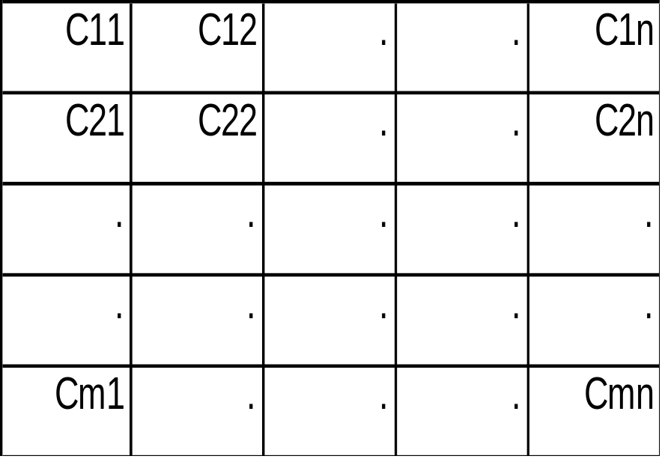
Assignment Problem
Jobs (Activities)
1 2 . . n
Cases
m = n
m ≠ n
Cij
Pij
Persons (Resources)
1
2
.
.
m
Cij = Cost associated with assigning i^{th}
resource to j^{th} activity

Slide 5
Categories of Assignment Problems
A. Balanced Minimization → m = n with Cij
B. Unbalanced Minimization →m ≠ n with Cij
C. Balanced Maximization → m = n with Pij
D. Unbalanced Maximization →m ≠ n with Pij

Slide 6
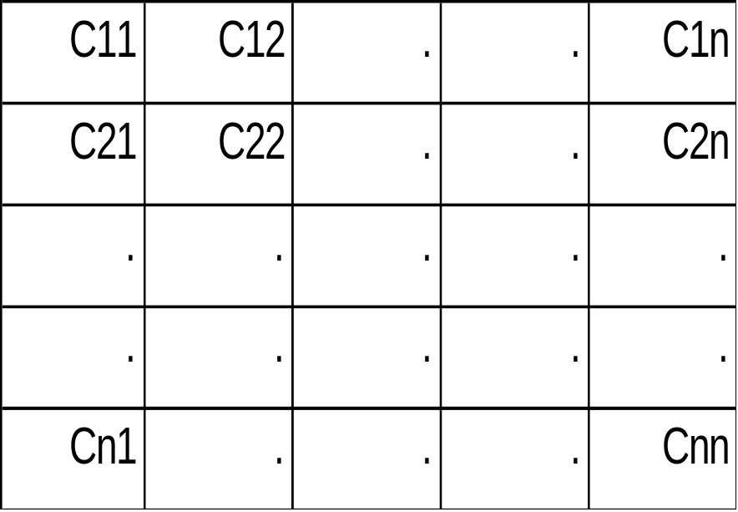
A. Balanced Minimization Problem
Jobs (Activities)
1 2 . . n
Persons (Resources)
1
2
.
.
n
Xij = assignment of i^{th} resource to j^{th}activity
Assignments are made on one to one basis

Slide 7
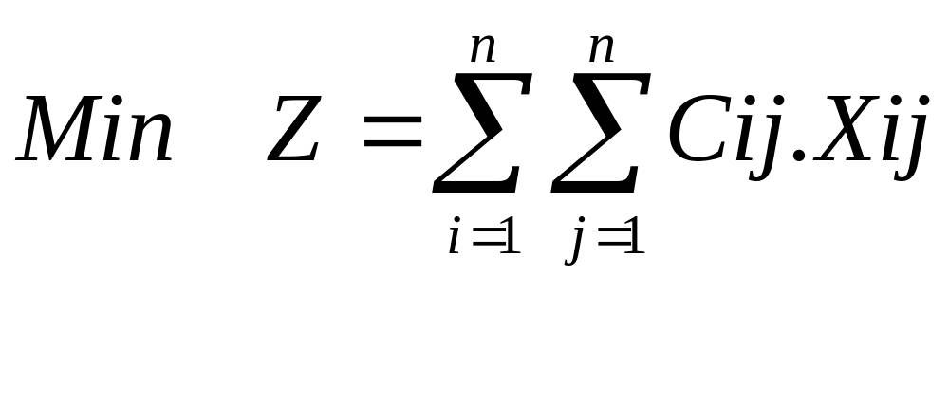
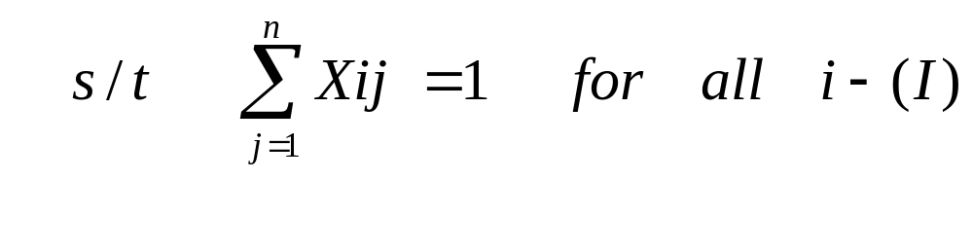
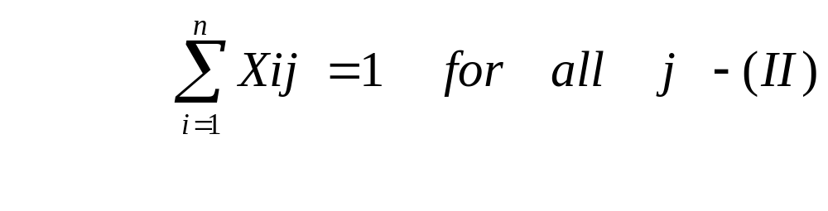
Formulation of Assignment Problem as LPP

Slide 8
Methods to solve Assignment Problems
1. Enumeration Method
2. Integer Programming Method
3. Transportation Method
4. Hungerian Method

Slide 9
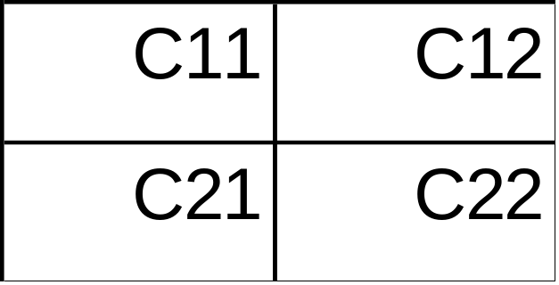
1. Enumeration Method
1 2
1
2
No. of Possible solutions =
2! (=2)
P1J1 , P2J2 OR P1J2 , P2J1
For 4 x 4 Problem---- 4! = 24
For 5 x 5 Problem----5! = 120
For n x n Problem---- n!

Slide 10
2. Integer Programming Method
All Xij = 0 or 1 → 0-1 Integer programming.
For n x n Problem → Variables = n x n.
Constraints = n+n = 2n
For 5 x 5 Problem → Variables = 25
Constraints = 10
Difficult to solve manually.

Slide 11
3. Transportation Method
Formulate the problem in Transportation Problem format.
1
1
.
1
1 2 . . n
1
2
.
.
n
1 1 . . 1

Slide 12
4. Hungerian Method
(Mr. D. Konig - A Hungerian Mathematician)
Steps :
1. Row Deduction
2. Column Deduction
3. Assign zeros-If all assignments are over,
Then STOP
Else Go To Step 4
4. Adopt Tick Marking Procedure
5. Modify Cij and Go To Step 3

Slide 13
Problem 1. Minimization Problem
1 2 3
1
2
3
19
28
31
11
17
16
12
15
13
Perform Row Deduction

Slide 14
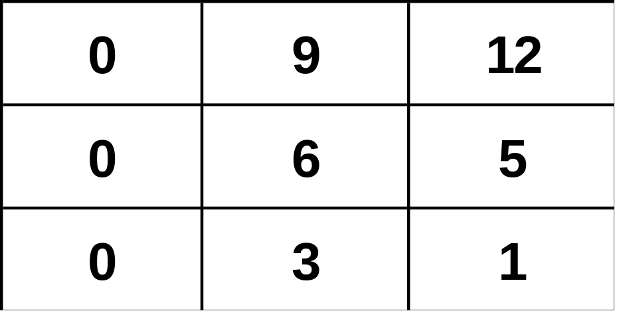
Row Deduction
1 2 3
1
2
3
Perform Column Deduction

Slide 15
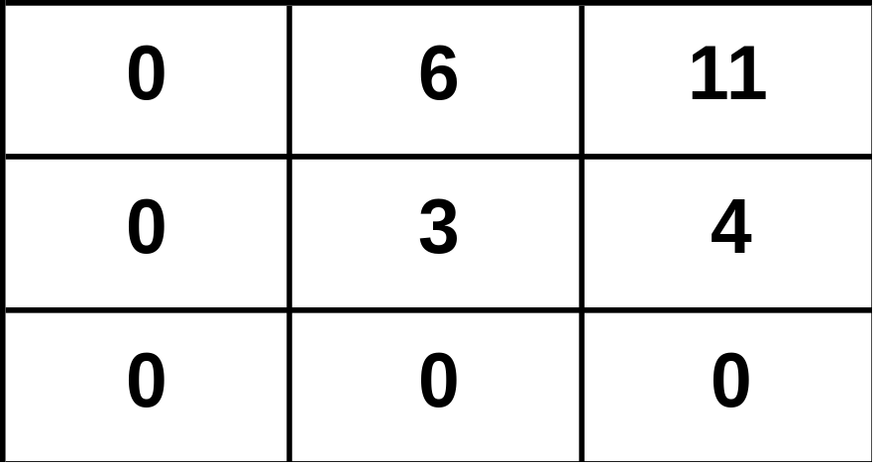
Column Deduction
Assign Zeros
Adopt Tick Marking
1 2 3
1
2
3
Minimum uncrossed no = 3.
Modify Numbers

Slide 16
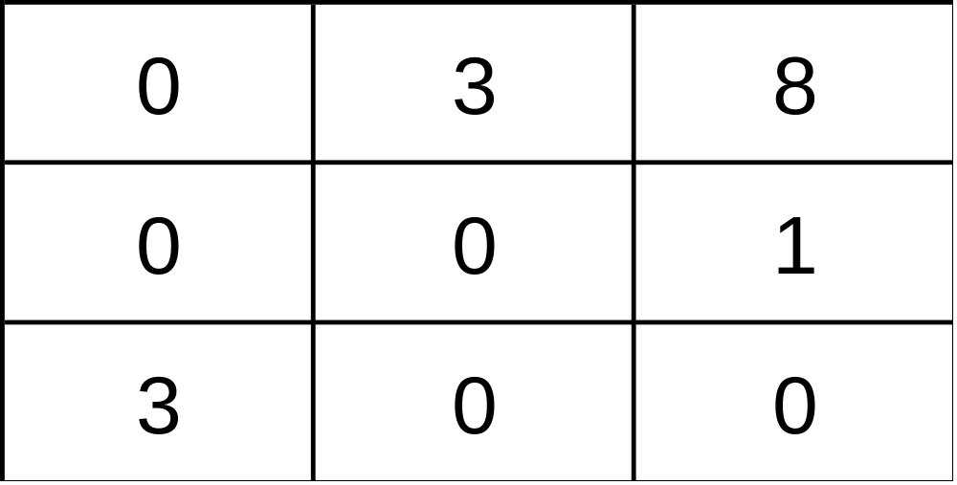
1 2 3
1
2
3
Hence optimal solution is
P1J1, P2J2, P3J3 giving Z = 19+17+13 = 49

Slide 17
Procedure of Assigning Zeros
Steps to be followed, after getting at-least one zero in each row & each column.
1. Start with 1st row. If there is only one uncrossed, unassigned zero, assign it & cross other zeros in respective column (of assigned zero), if they exits, else go to next row. Repeat this for next all other rows.
2. If still uncrossed, unassigned zeros are available, start with first column. If there is only one uncrossed, unassigned zero, assign it and cross other zeros in respective row of assigned zero, if they exit, else go to next column. Repeat this for next all other columns.
3. Repeat 1 & 2 until single uncrossed, unassigned zeros are available, while going through rows & columns.
4. If still multiple uncrossed, unassigned zeros are available while going through rows & columns, it indicates that multiple (alternative) optimal solutions are possible.
Assign any one remaining uncrossed, unassigned zero & cross remaining zeros in respective row & column of assigned zero. Then go to 1.
5. If required assignments are completed then STOP, else perform “Tick Marking Procedure”. Modify numbers & go to 1.

Slide 18
Tick marking Procedure
(To draw minimum number of lines through zeros.)
1. Tick marks row/rows where there is no assigned zero.
2. Tick mark column/columns w.r.t. crossed zero/zeros in marked row/rows.
3. Tick mark row/rows w.r.t. assigned zero in marked column/columns.
4. Go to to step 2 and repeat the procedure until no zero is available for tick marking.
Then
5. Draw lines through unmarked rows and marked columns
(Check no. of lines = No. of assign zeros)

Slide 19
Tick marking Procedure
(Continue)
How to Modify numbers ?
Find minimum number out of uncrossed numbers.
1. Add this minimum number to crossings.
2. Deduct this number from all uncrossed numbers one by one .
3. Keep crossed numbers, on horizontal & vertical lines,
except on crossing, same

Slide 20
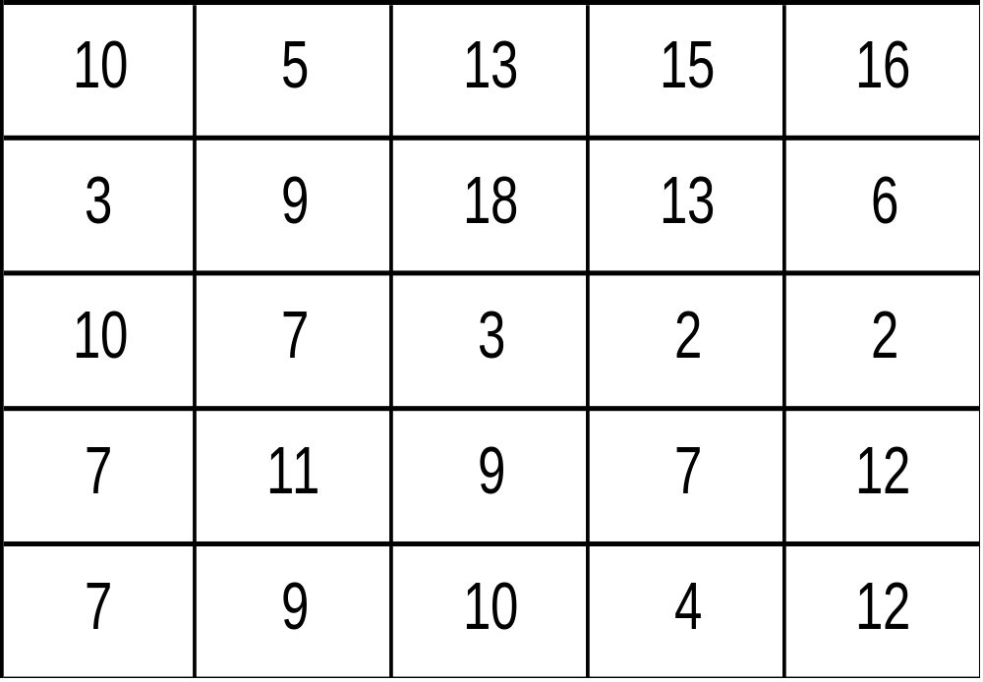
Problem 2.
Jobs (Activities)
1 2 3 4 5
Persons (Resources)
1
2
3
4
5

Slide 21
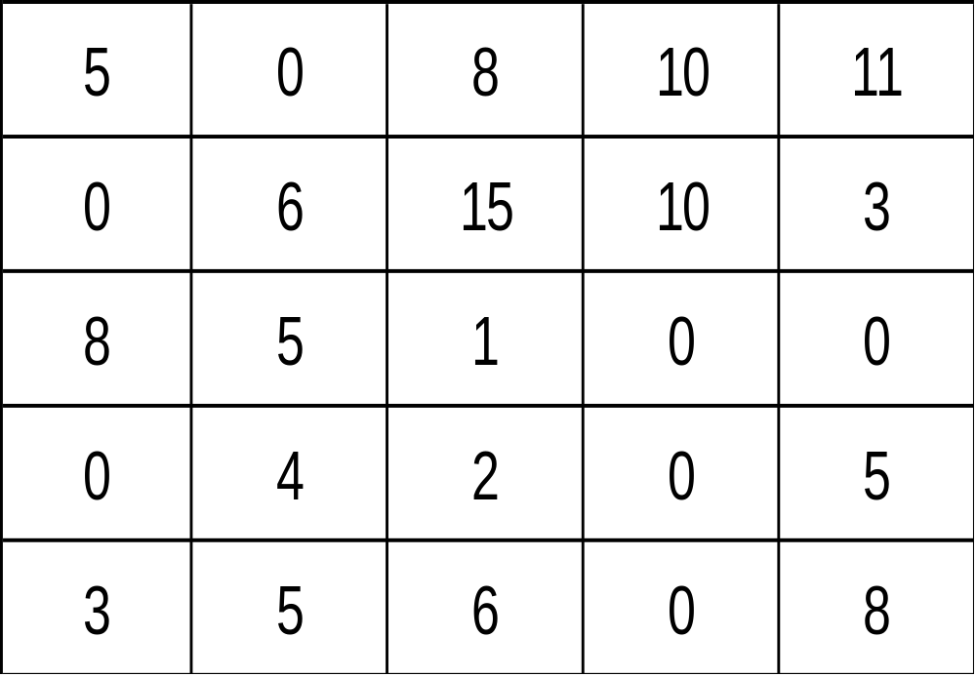
Jobs (Activities)
1 2 3 4 5
Persons (Resources)
1
2
3
4
5

Slide 22
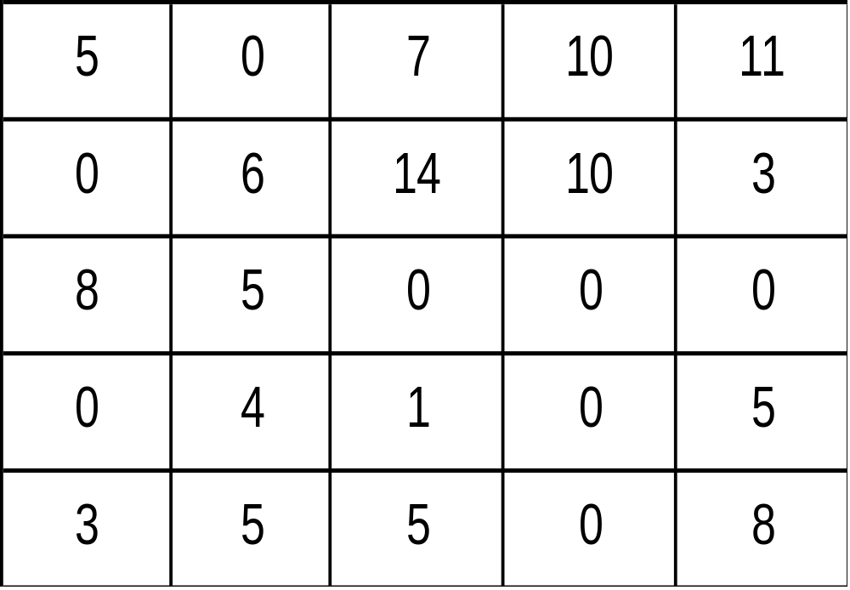
Minimum uncrossed Number = 1.
Jobs (Activities)
1 2 3 4 5
Persons (Resources)
1
2
3
4
5

Slide 23
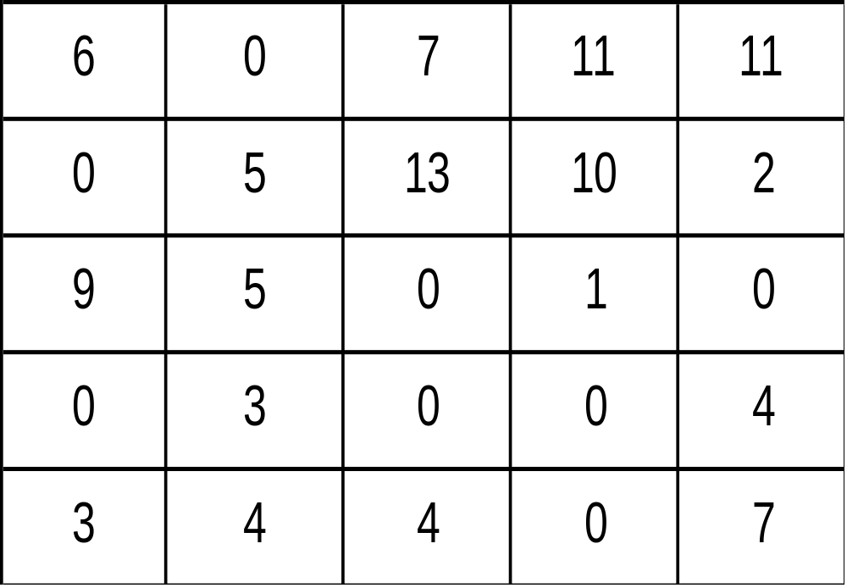
Jobs (Activities)
1 2 3 4 5
Persons (Resources)
1
2
3
4
5
Hence optimal solution is
P1J2, P2J1, P3J5, P4J3, P5J4 giving Z = 5+3+2+9+4 = 23

Slide 24
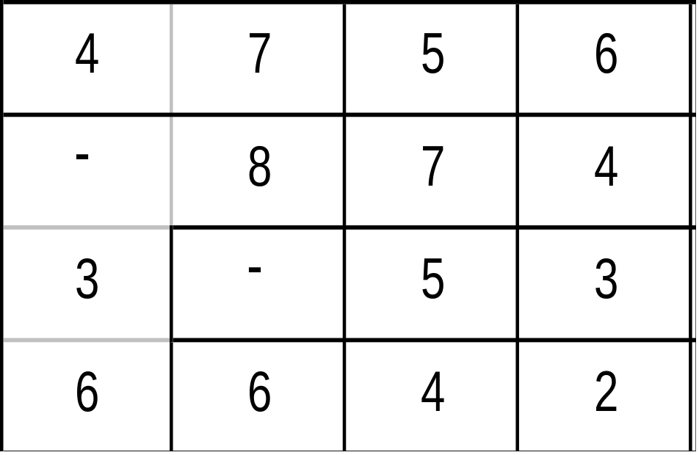
Problem 3.
Persons (Resources)
Jobs (Activities)
1 2 3 4
1
2
3
4

Slide 25
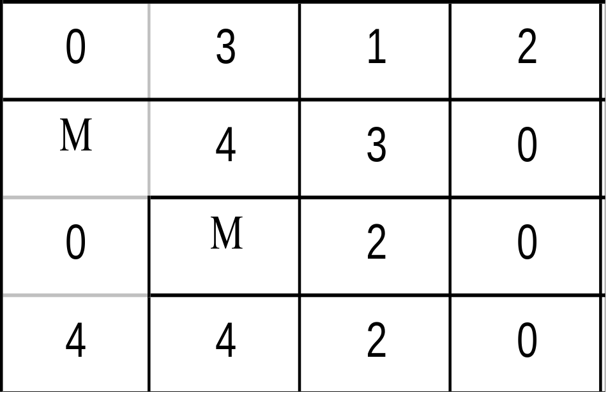
After Row deduction →
Persons (Resources)
Jobs (Activities)
1 2 3 4
1
2
3
4

Slide 26
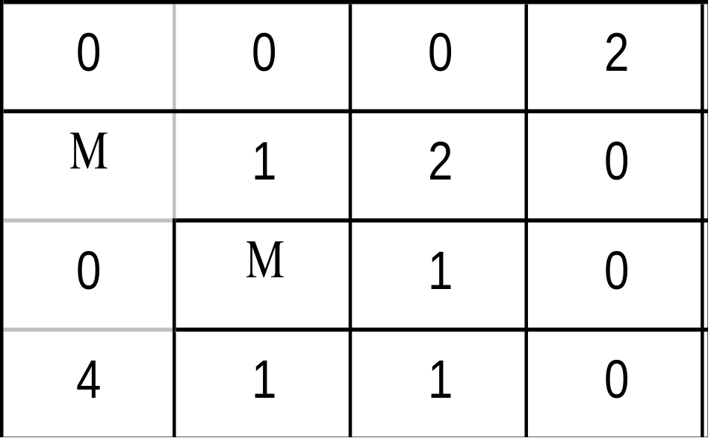
After Column deduction →
Persons (Resources)
Jobs (Activities)
1 2 3 4
1
2
3
4
Now modified matrix will be :

Slide 27
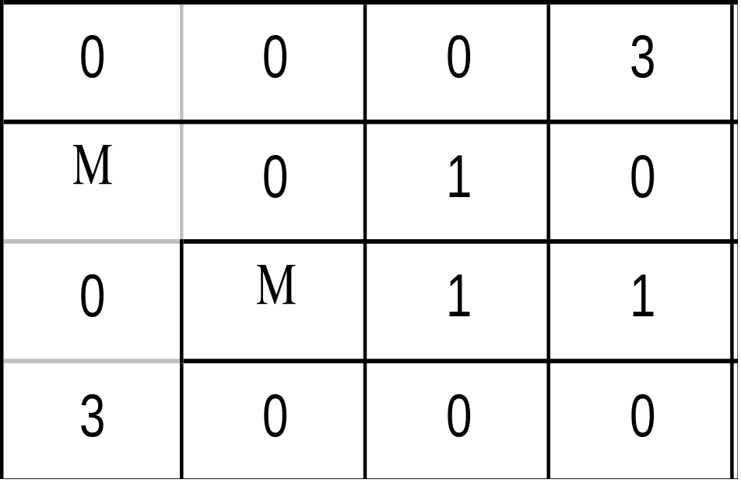
Persons (Resources)
Jobs (Activities)
1 2 3 4
1
2
3
4
Hence, this is a case of alternative optimal solutions.
Assign any one remaining zero and cross existing zeros in respective row and column, then apply assigning procedure.
Hence, one of the optimal solutions is P1J2, P2J4, P3J1, P4J3 giving Z = 7+4+3+4 = 18

Slide 28
To get another optimal solution, assign another remaining zero.
Persons (Resources)
Jobs (Activities)
1 2 3 4
1
2
3
4
P1J3 can not be assigned, as it is already assigned before.
Hence, another optimal solution is P1J3, P2J2, P3J1, P4J4 giving Z = 5+8+3+2 = 18

Slide 29
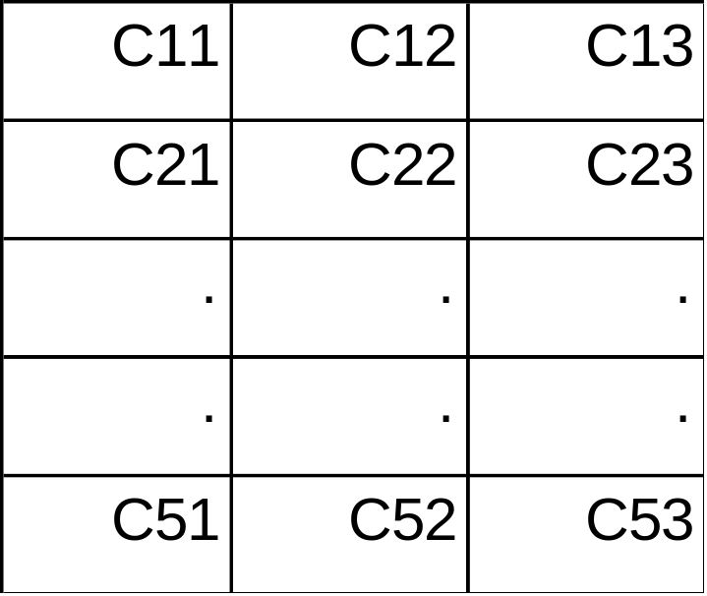
B. Unbalanced Minimization Problem
Jobs (Activities)
1 2 3
Persons (Resources)
1
2
3
4
5
D1 and D2 Dummy Jobs are to be introduced
to balance the problem

Slide 30
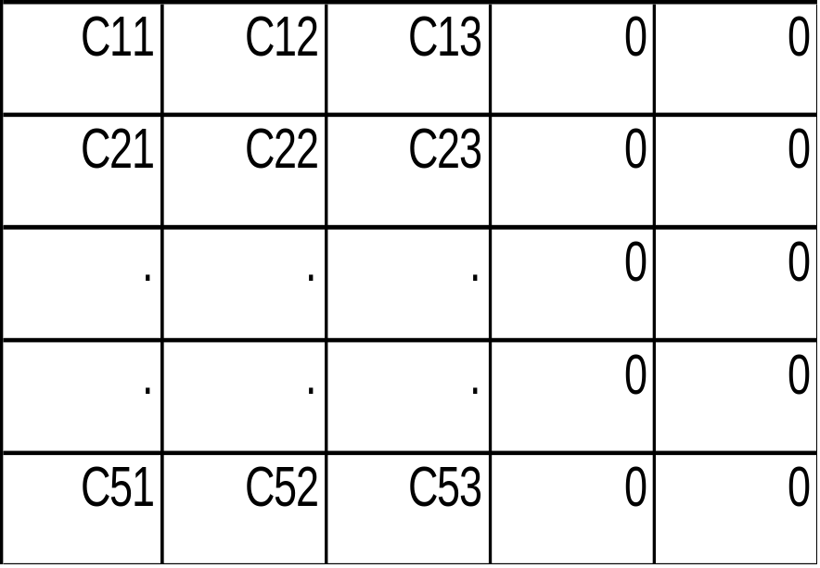
Jobs (Activities)
1 2 3 D1 D2
Persons (Resources)
1
2
3
4
5
D1 and D2 are Dummy Jobs : Cij = 0

Slide 31

C. Balanced Maximization Problem
Jobs (Activities)
1 2 3 4 5
Persons (Resources)
1
2
3
4
5
Pij
Convert Profit Matrix into Relative Cost
Matrix

Slide 32
How to Convert Profit Matrix into
Relative Cost Matrix ?
1. (Pij) (-1) = RCij
2. 1/Pij = RCij
3. (Pij)max - Pij = RCij

Slide 33

D. Unbalanced Maximization Problem
Jobs (Activities)
1 2 3
Persons (Resources)
1
2
3
4
5
Pij
Convert Unbalanced Profit Matrix into
Unbalanced Relative Cost Matrix
Then Balance the matrix and solve

Slide 34
Typical Cases in Assignment Problems
1. Restriction in Assignment.
e.g. Assignment of P3 to J4 is not possible.
Then C34 = M (Big Number)
2. Alternative Optimal Solution Possibility
-Already considered.
3. Particular assignment is prefixed.
e.g. If P3 & J4 prefixed
Then Row3 & Column4 are deleted.

Slide 35
Recapitulate
  Methods to solve Assignment
  Problem
  Hungerian Method Application
  Typical cases of Assignment
  Problems

Slide 36
Home Assignments :

Slide 37
[ 1 ] Three new automatics feed devices (1 – 3) have been made available for existing punch presses. Six presses (A – F) in the plant can be fitted with these devices. The plant superintendent estimates that the increased output, together with the labour saved will result in the following Rupees increase in profits per day. Determine which presses should receive the feed devices so that the benefit to the plant is maximized.
A B C D E F
1 12 17 22 19 17 18
2 21 19 20 23 20 14
3 20 21 20 22 21 17

Slide 38
[ 2 ] Consider the problem of assigning four operators (O1–O4)
to four machines (M1 to M4). The assignment costs are given
in Rupees. Operator 1 cannot be assigned to machine 3. Also
operator 3 cannot be assigned to machine 4. Find the optimal
assignment.
M1 M2 M3 M4
1 5 5 − 2
2 7 4 2 3
3 9 3 5 −
4 7 2 6 7
If 5th Machine is made available and the respective costs to
the four operators are Rs. 2, 1, 2 and 8. Find whether it is
economical to replace any of the four existing machines. If so,
which ?

Slide 39
[ 3 ] Five persons are available to do five different jobs. From past records time (in hours) that each person takes to do each job is known as shown. Find the optimal assignment.
Jobs
1 2 3 4 5
1 2 9 2 7 1
2 6 8 7 6 1
3 4 6 5 3 1
4 4 2 7 3 1
5 5 3 9 5 1
Persons

Slide 40
[ 4 ] The jobs J1, J2, J3 are to be assigned to three machines
M1, M2, M3. The processing costs in Rs. are given in the
matrix.
Find :
( i ) the best allocation ( ii ) the worst allocation.
M1 M2 M3
J1 19 28 31
J2 11 17 16
J3 12 15 13

Slide 41
[ 5 ] A head of department has five jobs A, B, C, D & E and five subordinates V, W, X, Y & Z who are capable of carrying out the jobs. He assesses the number of hours each man would take to perform each job as given in matrix. How should the jobs be allocated to the men to optimize the situation ?
V W X Y Z
A 3 5 10 15 8
B 4 7 15 18 8
C 8 12 20 20 12
D 5 5 8 10 6
E 10 10 15 25 10

Slide 42
Problems of Alternative Optimal Solutions :

Slide 43
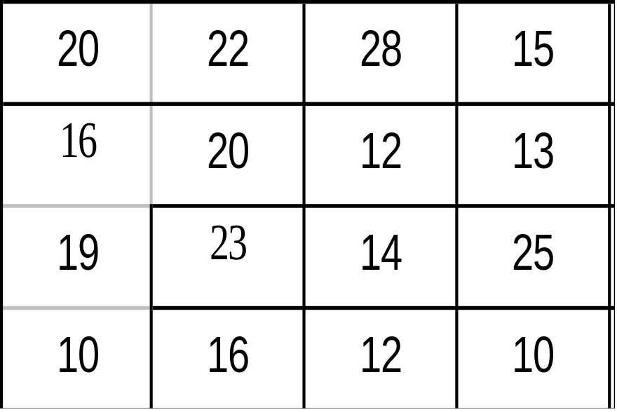
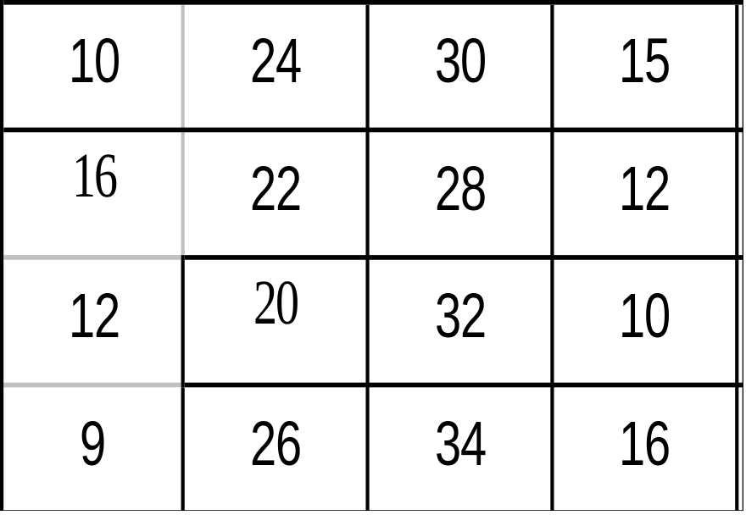
[ 1 ]
[ 2 ]

Slide 44
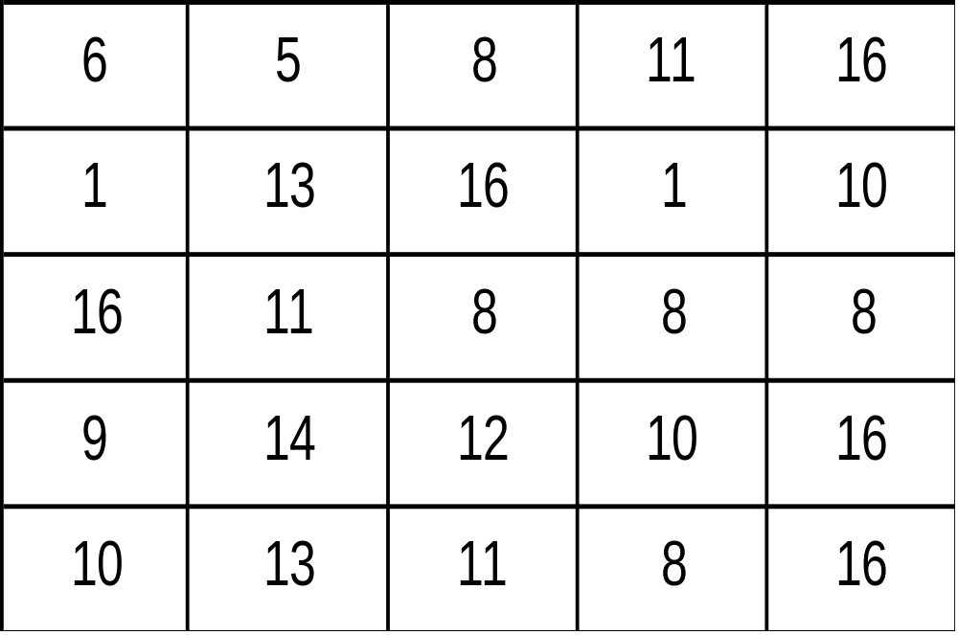
[ 3 ]

Slide 45
  Thank you
  For any Query or suggestion :
  Contact :
  Dr. D. B. Naik
  Professor, Training & Placement.
  Sardar Vallabhbhai National Institute of Technology, Surat
  Ichchhanath, Surat - 395007
  Email : dbnaik_svr@yahoo.com
  Phone No. 0261-2255225 (O)

